Slide 1

An introduction to bladder cancer
…and patient stratification research in the Mason Lab
Andrew Mason
andrew.mason@york.ac.uk
asmasonomics.github.io

Slide 2
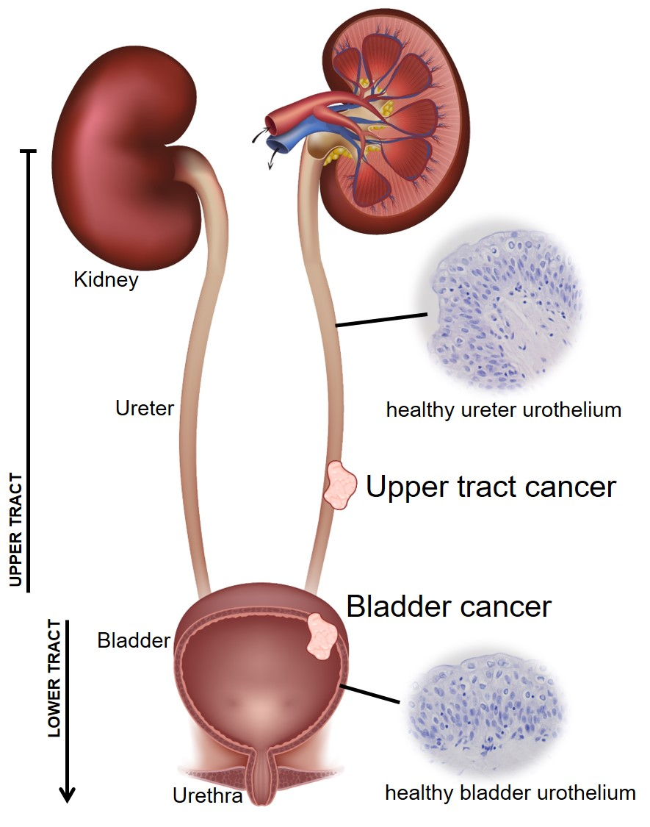
An introduction to the urinary tract
1
The urinary system falls into 2 distinct zones:
Upper urinary tract (kidneys and ureters)
Lower urinary tract (bladder and urethra)
The urinary tract experiences many pressures
Pathogens
Urinary toxins
Fluid pressure changes (incl. size/shape changes)

Slide 3
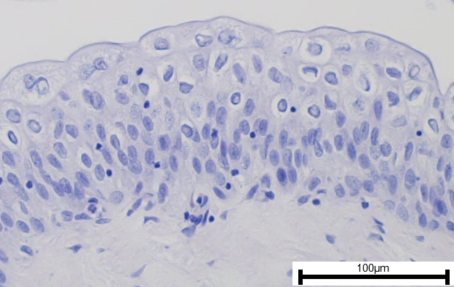
Urothelium – a highly specialised and barrier-forming epithelium
2
The urothelium is a specialised, transitional epithelial lining which spans the urinary system, from the kidney renal pelvis to the top of the urethra
Superficial “umbrella” cells
Infiltrated immune cells (resident?)
Intermediate cells
Basal cells
Additional relevant info
Urothelium is quiescent
Lamina propria
Basement membrane
(with underlying capillary bed)
There is no evidence for a urothelial stem cell
Superficial cells are not “more differentiated” than basal cells

Slide 4
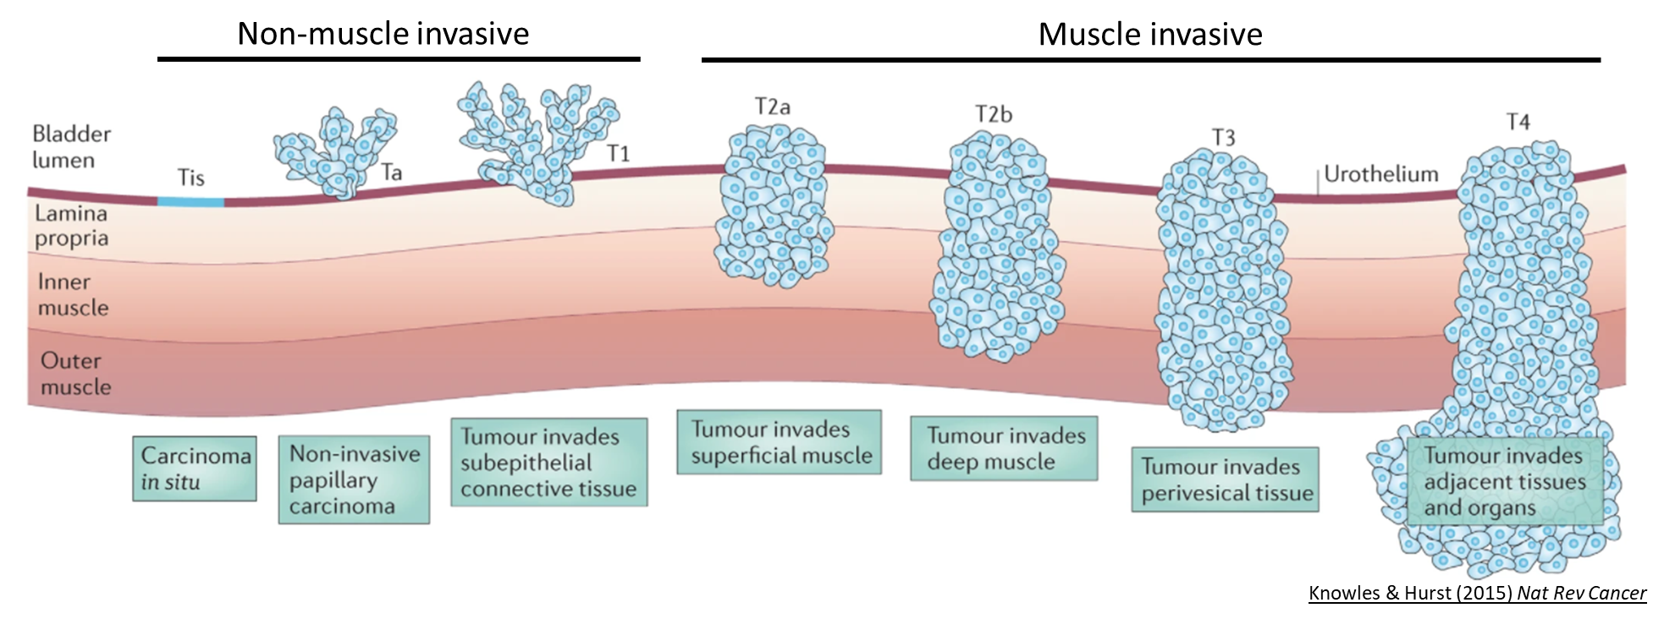
Urothelial carcinoma
3
In the global north, >95% of cancers between the renal pelvis and bladder neck are urothelial carcinoma (aka transitional cell carcinoma; TCC)
>92% are urothelial carcinoma of the bladder (UCB)
c.8% are upper tract urothelial carcinoma (UTUC)
UTUC (c.2/100,000)
60% present at T2+
Luminal (immune-poor) tumours
1/3 patients go on to develop UCB
Treatment based on UCB research
UCB (c.20/100,000)
80% present <T2 (non-invasive)
Highly recurrent
Very expensive aftercare
MIBC 5-year survival <50%
MIBC is molecularly diverse

Slide 5
What causes urothelial carcinoma?

Slide 6
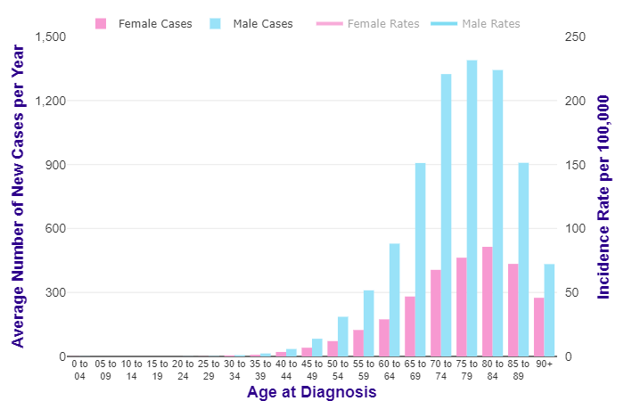
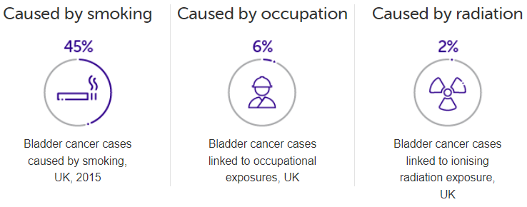

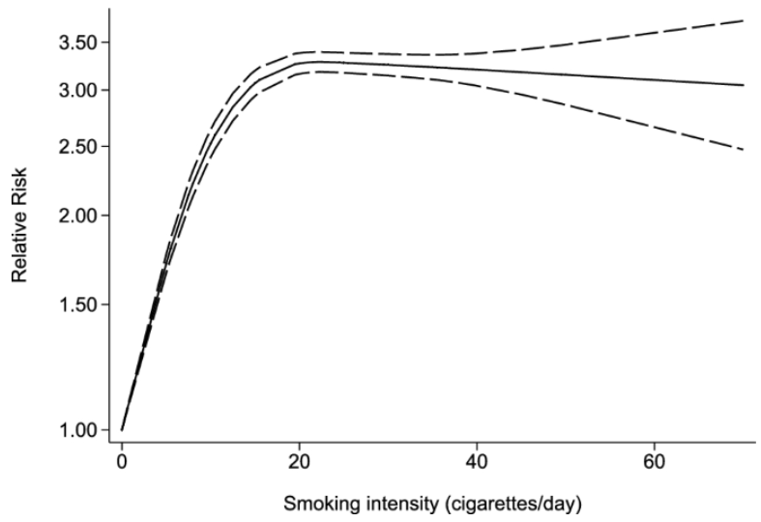
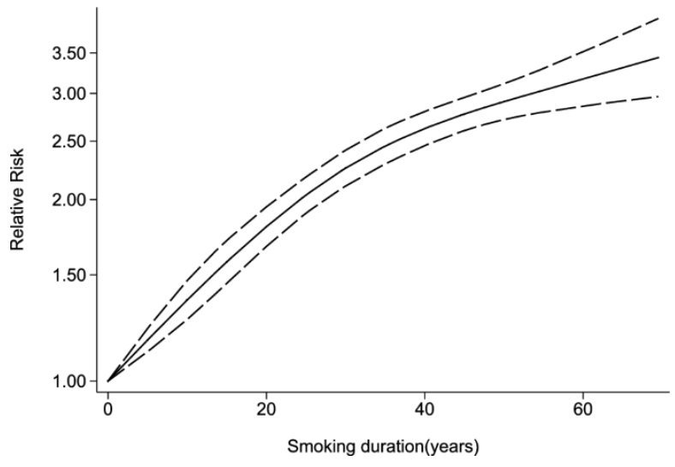
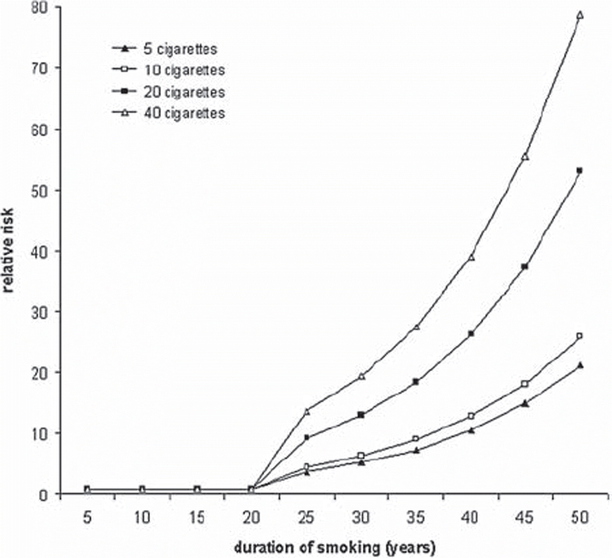
Well established risk factors include age, sex and smoking
5
Urothelial carcinoma has high mutational burden and, consequently, diverse driver genes
Smoking relationship different in lung cancer
Zhao et al (2022) meta-analysis in bladder cancer
PMID:35332429
Didkowska et al (2011; PMID:20553096) from data in Simonata et al (2001; PMID:11275995)

Slide 7
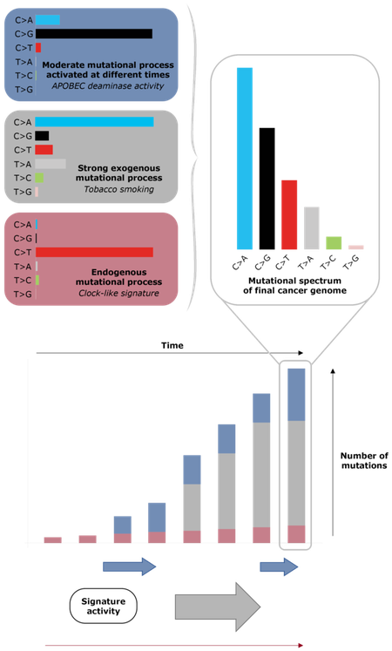
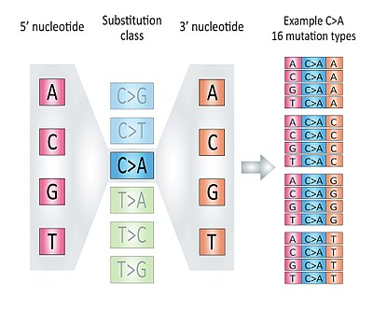
Mutational patterns can tell us more about cancer causes
6
Urothelial carcinoma has high mutational burden and, consequently, diverse driver genes
High mutational burden allows us to construct mutational signatures very confidently
Specific base change, plus surrounding chemistry creates very specific signatures of mutational processes

Slide 8
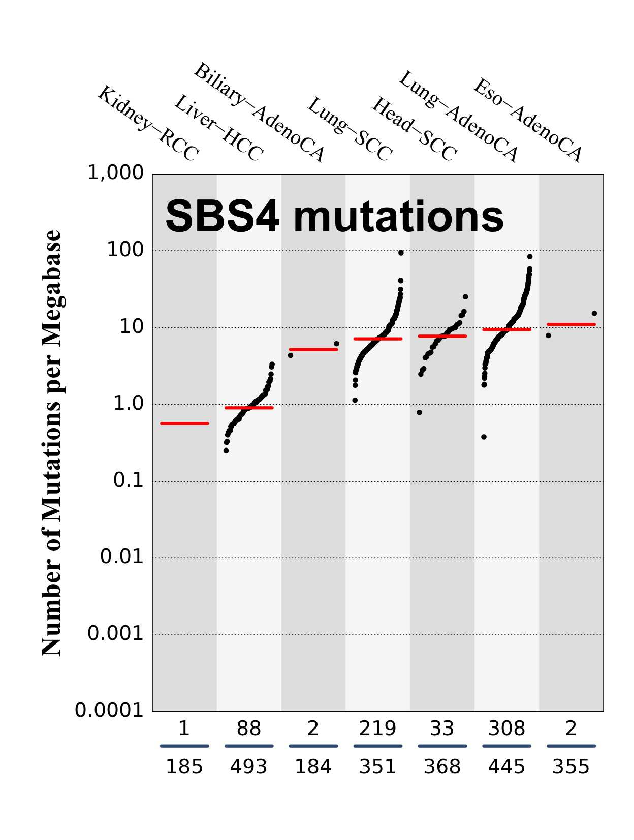
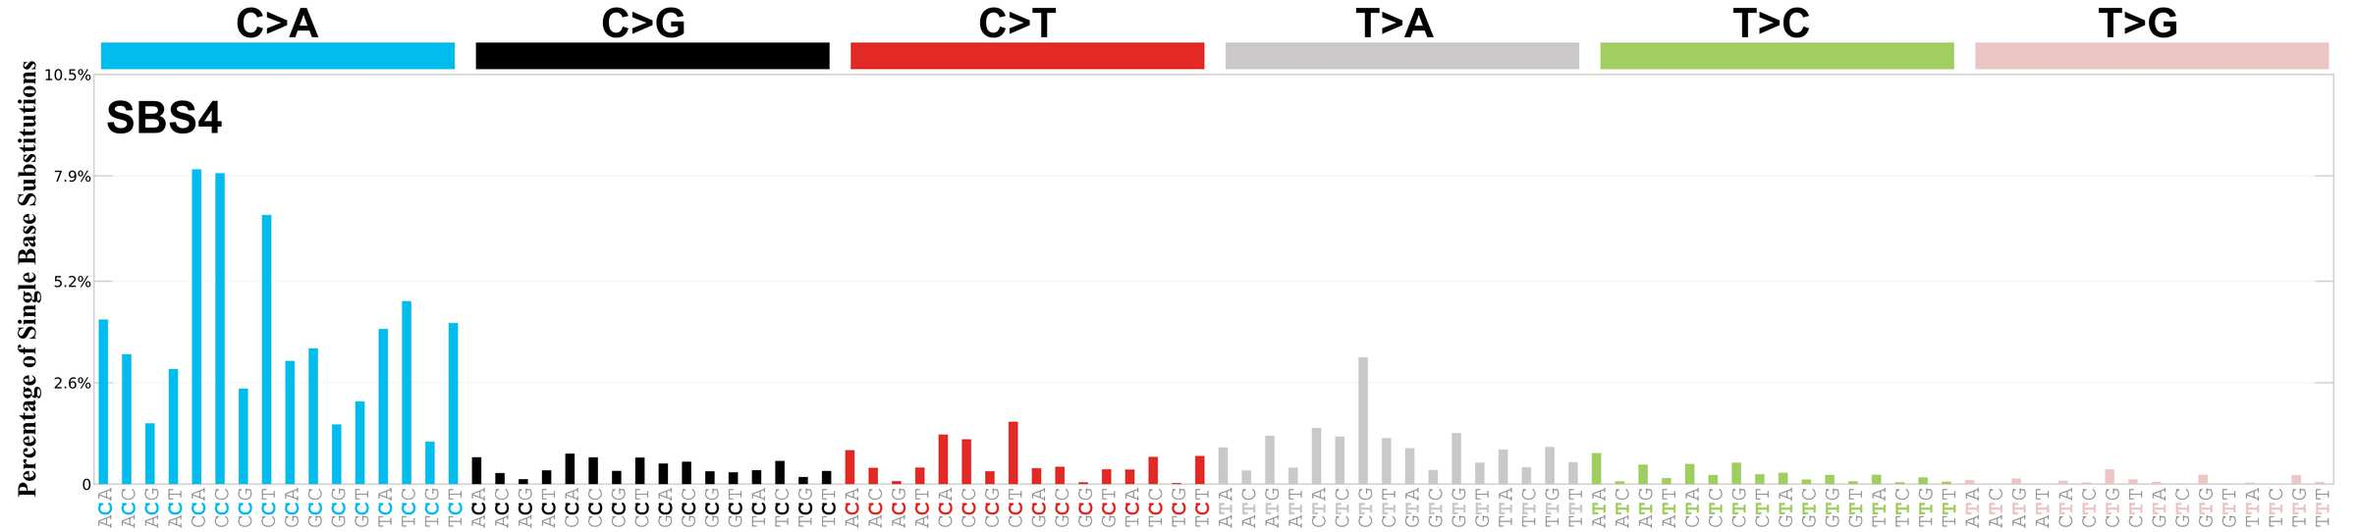
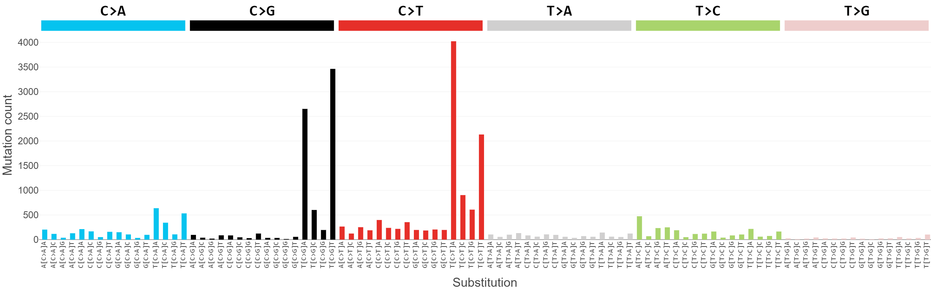
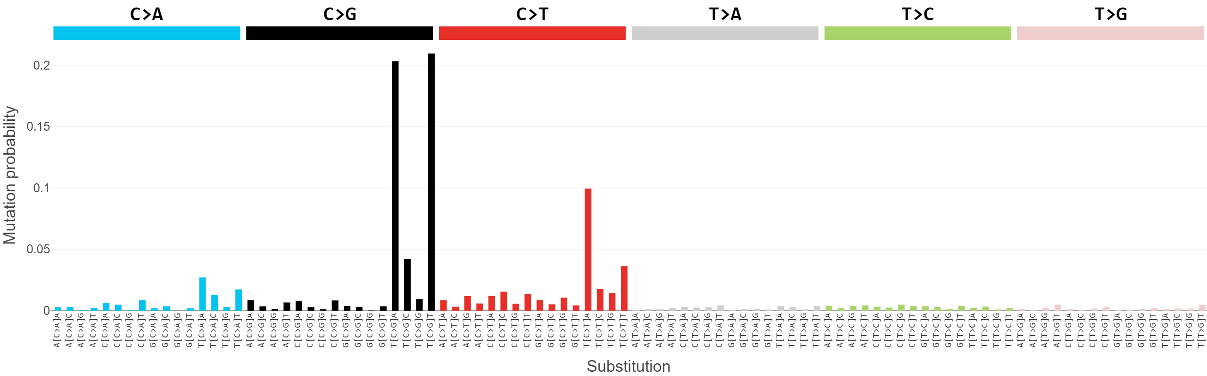
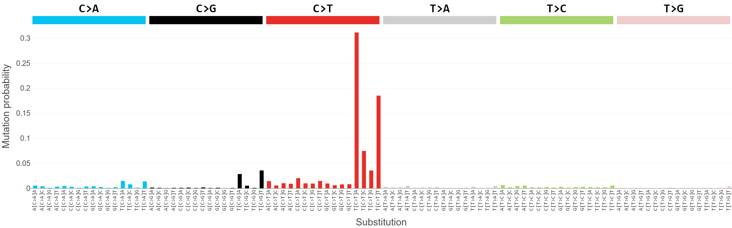
Bladder cancer doesn’t display typical patterns of smoke-based mutagenesis
7
Urothelial carcinoma has high mutational burden and, consequently, diverse driver genes
High mutational burden allows us to construct mutational signatures very confidently
Smoking signature characteristic in lung cancer
Typical bladder cancer mutational signature
APOBEC mutagenesis
SBS13
SBS2

Slide 9
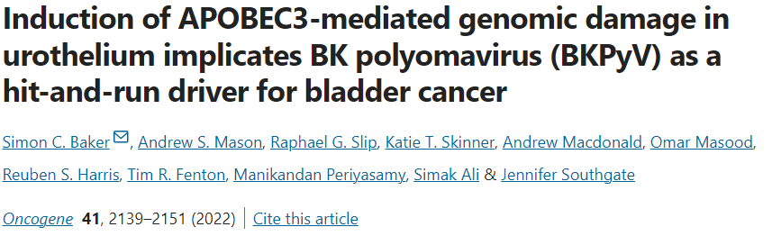
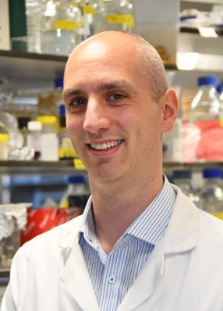

What evidence of viral damage?
8
Urothelial carcinoma has high mutational burden and, consequently, diverse driver genes
High mutational burden allows us to construct mutational signatures very confidently
Mutational signatures (and epidemiological data) now support a viral cause of urothelial carcinoma
Additional relevant info
Mice do not get the relevant virus
Smoking may dampen the immune system and/or specific toxins may damage urothelium and facilitate viral infection
Mice do not have the relevant APOBEC3 enzymes
Mice UC models are chemically-induced
Rodent urothelium is different
Rodents are effectively incontinent

Slide 10
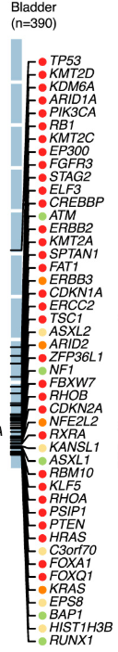
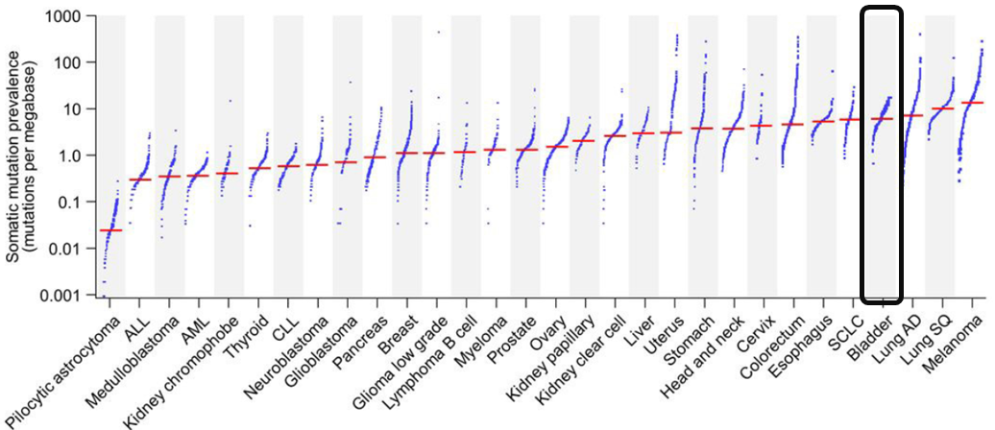
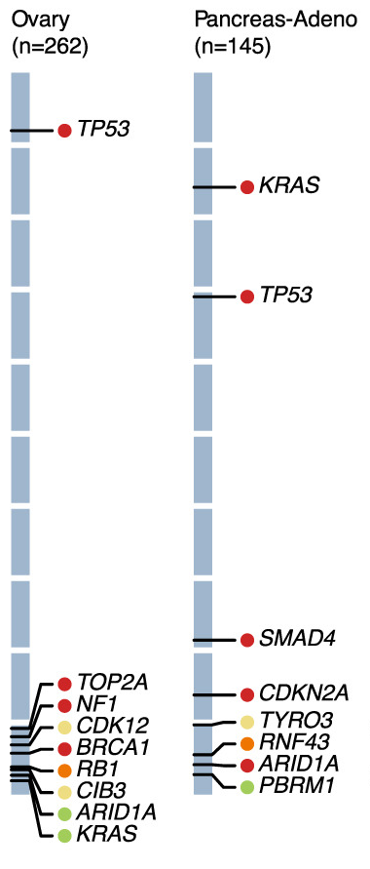
Urothelial carcinoma is a diverse disease without clear mutational subtypes
9
Very high mutational burden (TMB) and diverse driver genes
For comparison
Unclear which are tumour drivers, and which are unimportant passengers
Diverse pathways to try to find druggable targets
Issues with pathway redundancy and pathway interactions

Slide 11
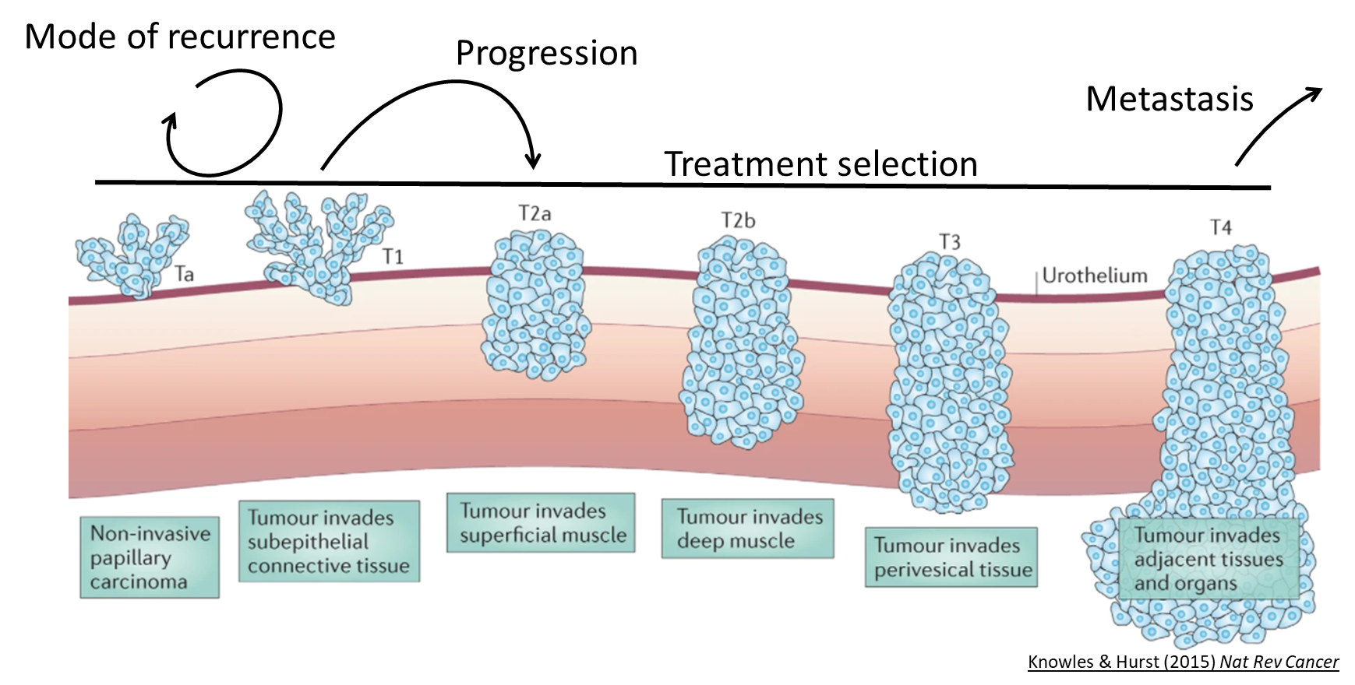

Not all bladder cancers are equal
10
Can we use data to personalise patient experience and treatment?

Slide 12
The problem is stratification

Slide 13
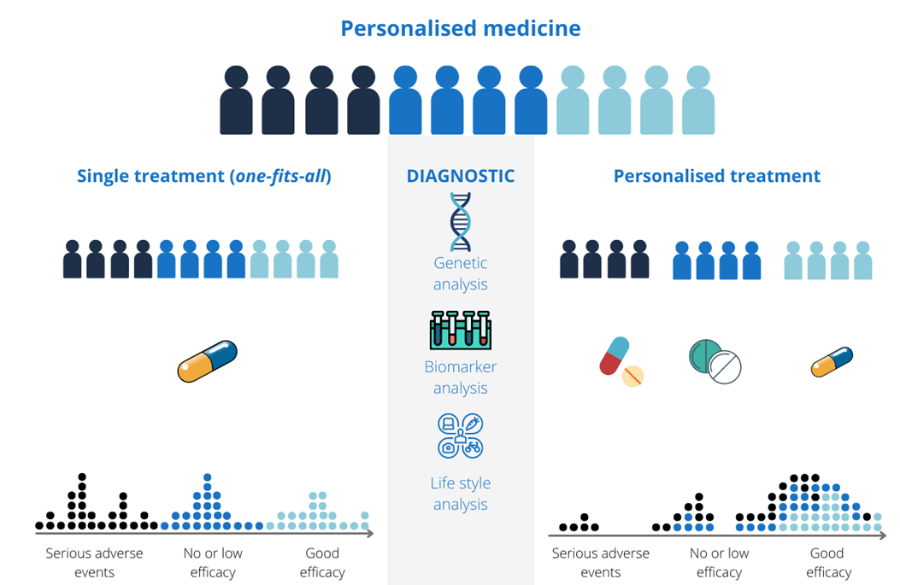
Stratification is an achievable middle ground towards personalised medicine
12
(more)
The “right” data
Unsupervised clustering → finding order without knowing the answer

Slide 14
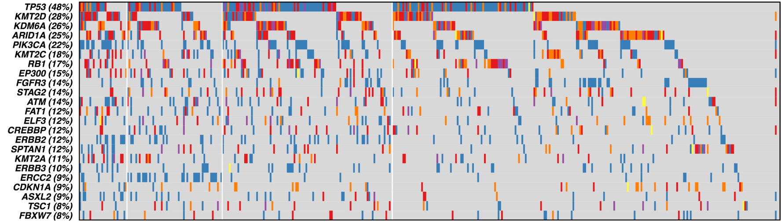
Mutational subgroups not an option
13
Mutations are appealing as they are easy and cost-effective to profile, and often give clear binary answers
Overlaps between different mutation types
Difficult to predict the impact of each mutation
Very limited data on mutation interactions
High number of mutations found in only one or two patients

Slide 15
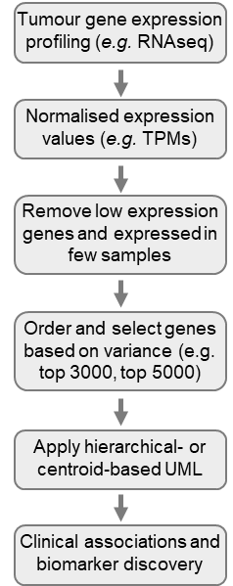
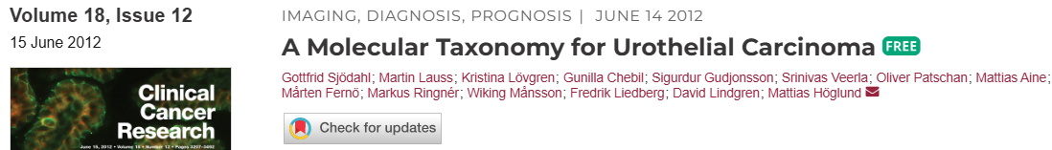

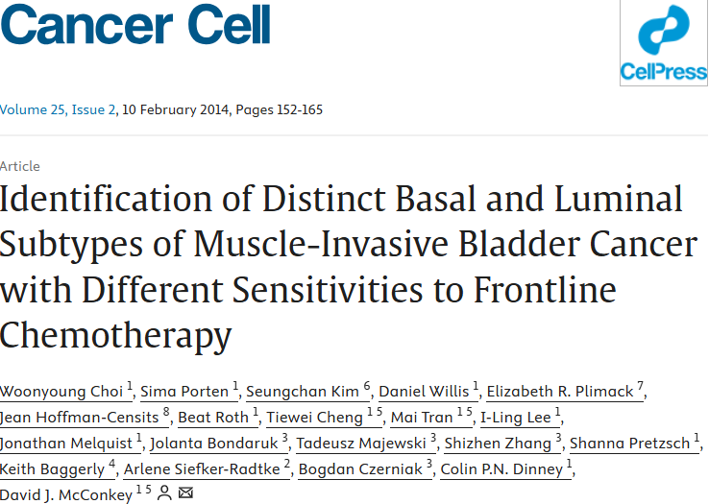
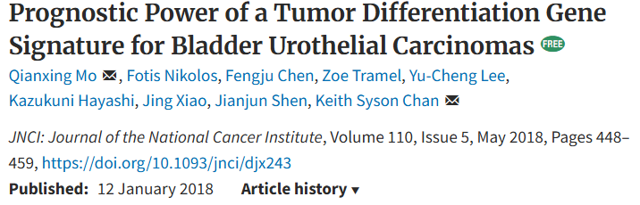
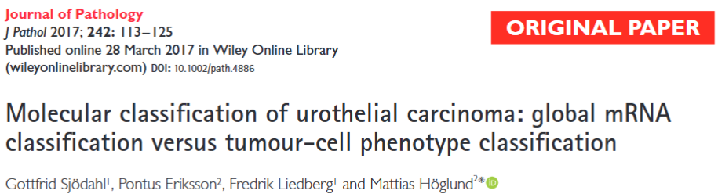
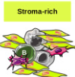

Gene expression subtypes could only describe - the clinical links were weak
14
As with many cancers, BLCA research focused on gene expression profiles in the 2010s
Standard approach → retain “most variable” genes, dimension reduction, most parsimonious number of groups
Tumour sequencing includes TME and adjacent tissue – combination of surgical sampling “error” and actual biology
Can derive groups based on “contamination”

Slide 16

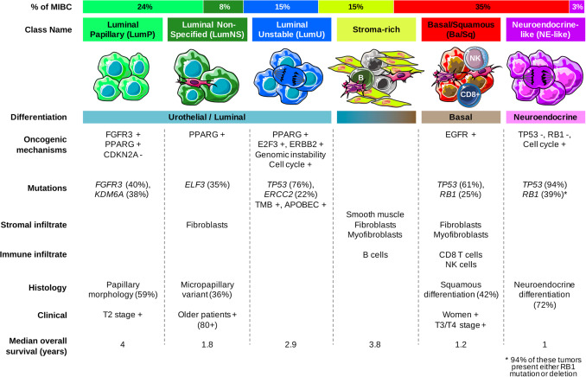
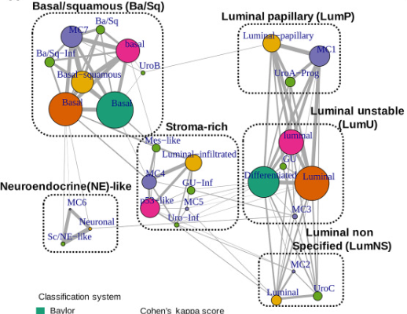
A “consensus” strategy
15

Slide 17
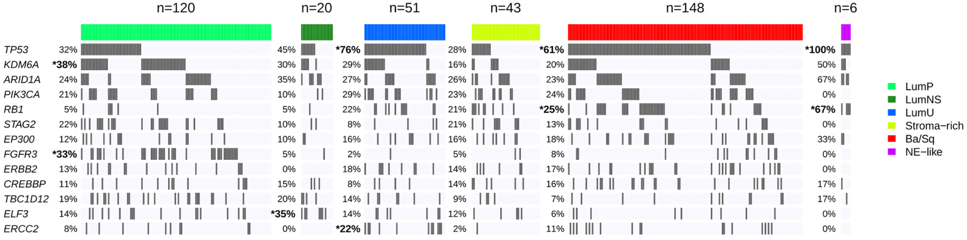
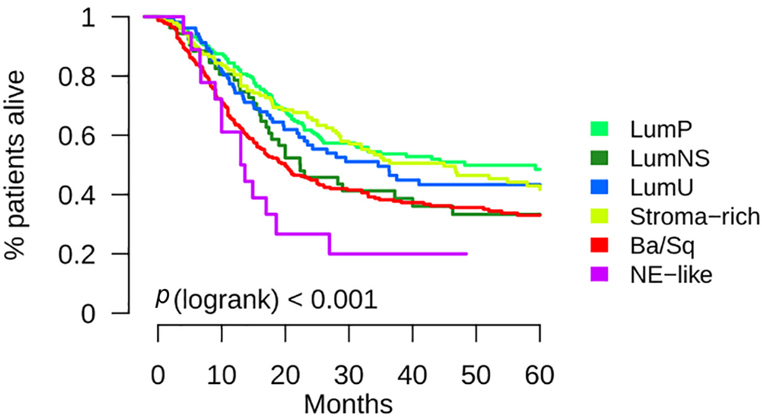
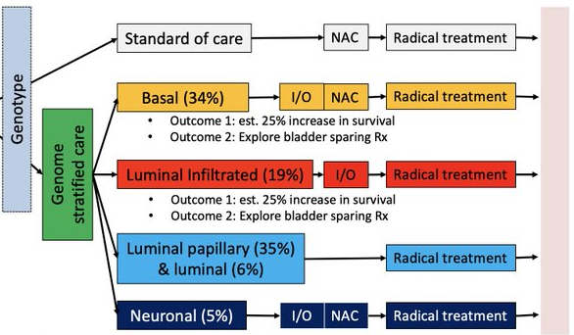
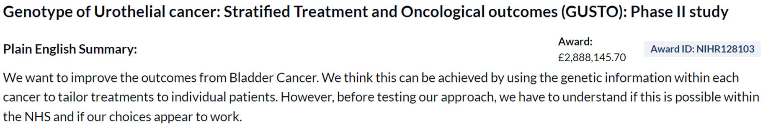
The consensus still did not yield clinically relevant groups
16
“Clinically relevant” mutations were still very divided
Limited differences in patient outcome
There are some propensities for treatment response → opportunities for trials

Slide 18
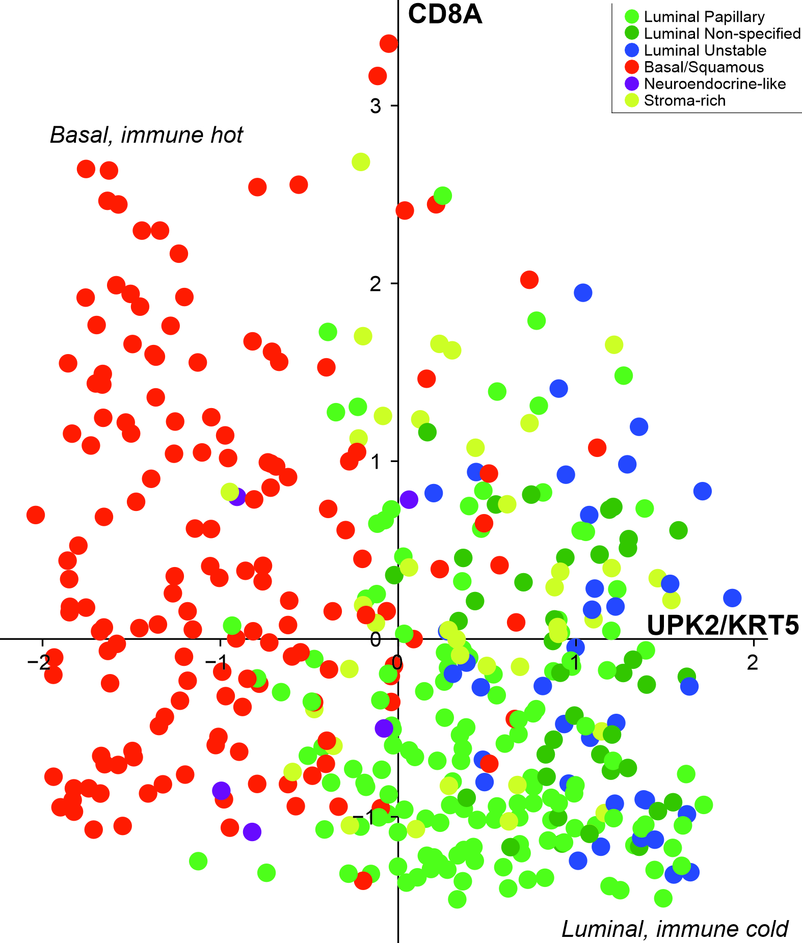
Bladder cancer is a disease continuum
17
Despite this work, we can largely represent MIBC molecular subtypes with 3 genes / 2 axes
basal/luminal differentiation state
immune activity
New classification systems already proposed
THE PROBLEMS
ML is giving us very limited gains in understanding
Subgroupings are arbitrary
- Even splits
- Group edge cases swap with new annotations, different filtering strategies etc.
Subgroupings are academic, not clinical

Slide 19
We can’t rely on data alone.
Biological knowledge is essential.

Slide 20


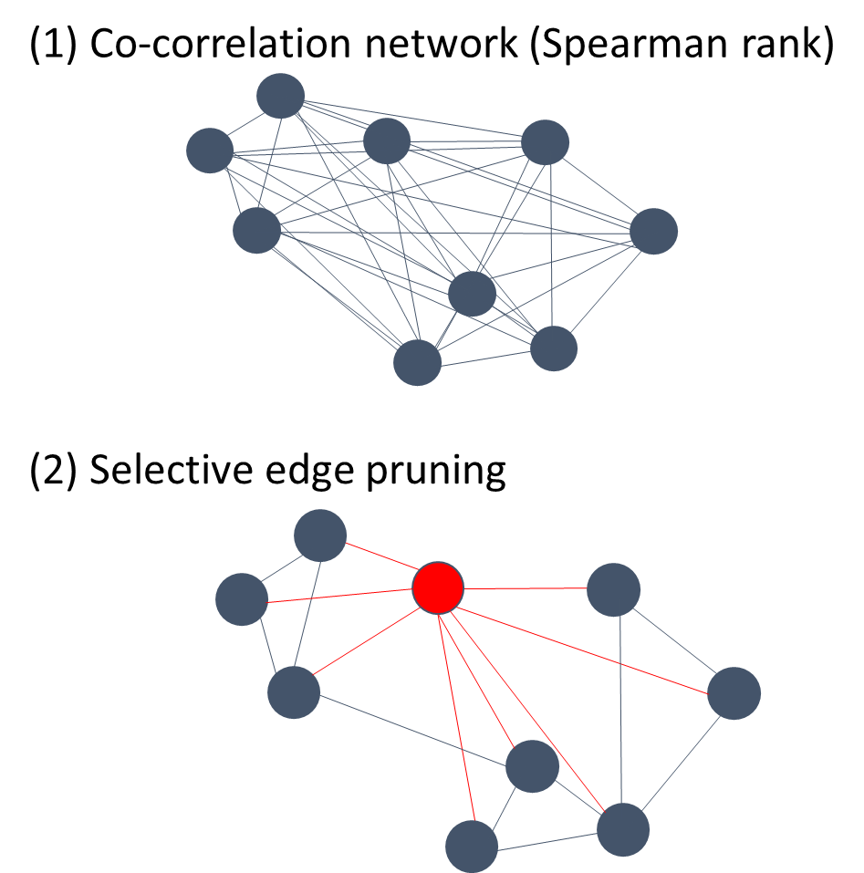
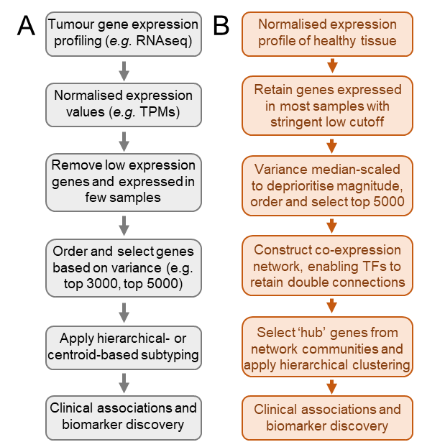
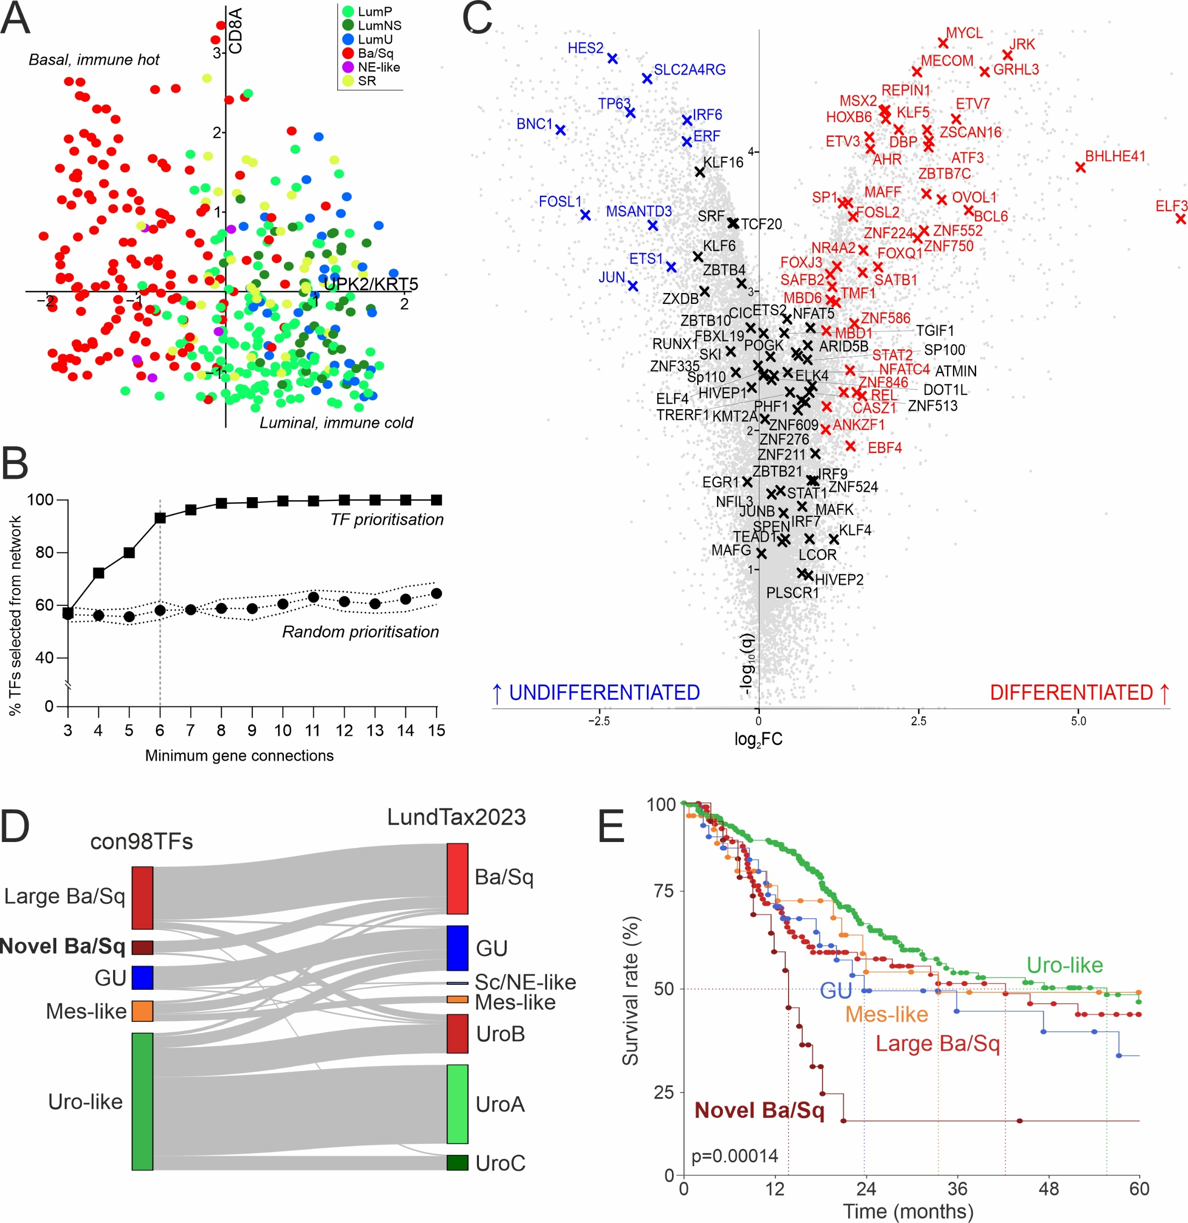
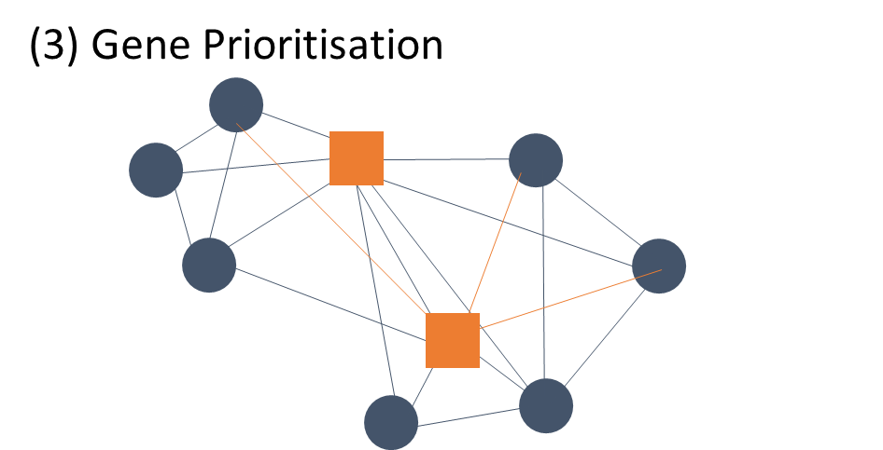
A case study in this strategy (i)
19
Standard
Biology-driven

Slide 21

A case study in this strategy (ii)
20
This approach allowed us to choose different genes to use as markers to stratify the cancers
This revealed a novel group of basal cancers with particularly bad survival

Slide 22
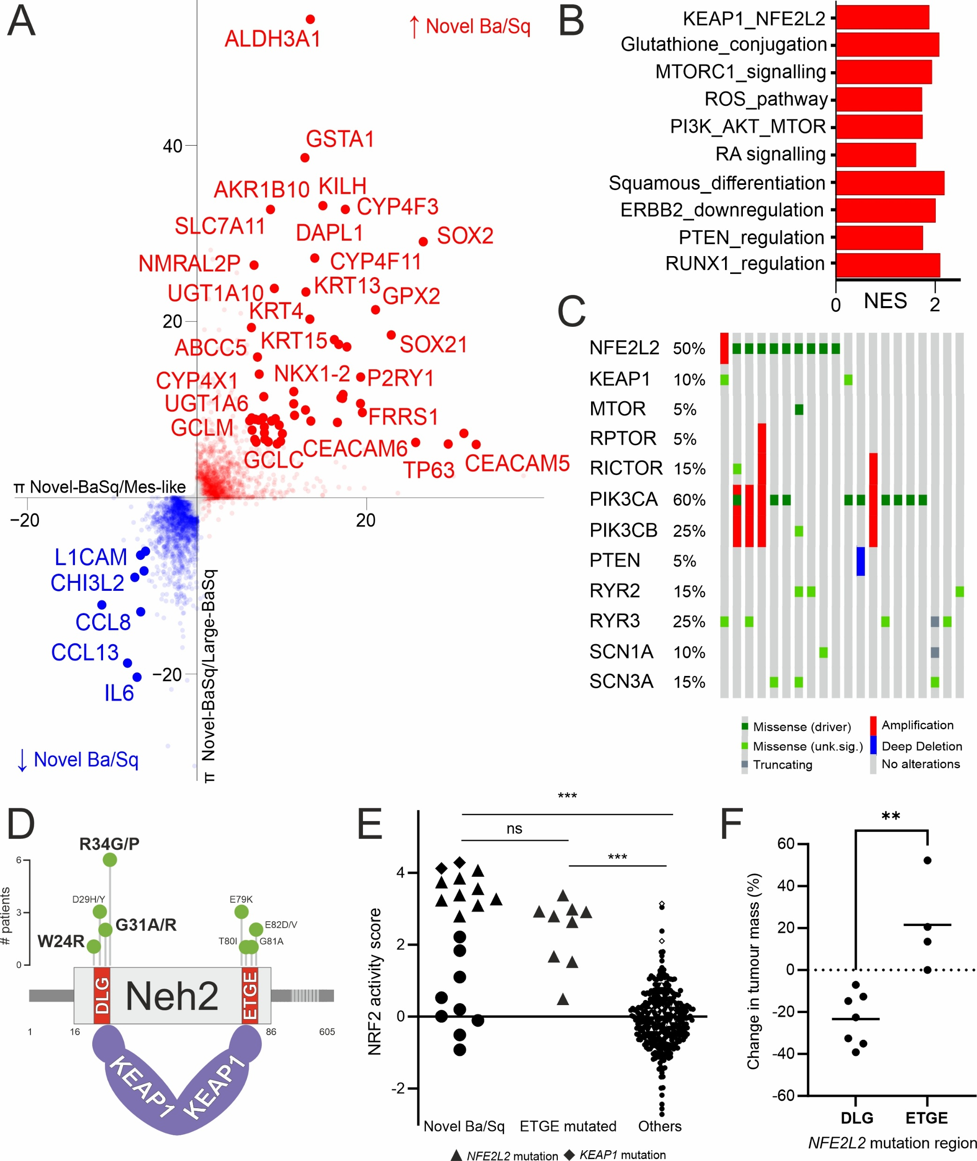


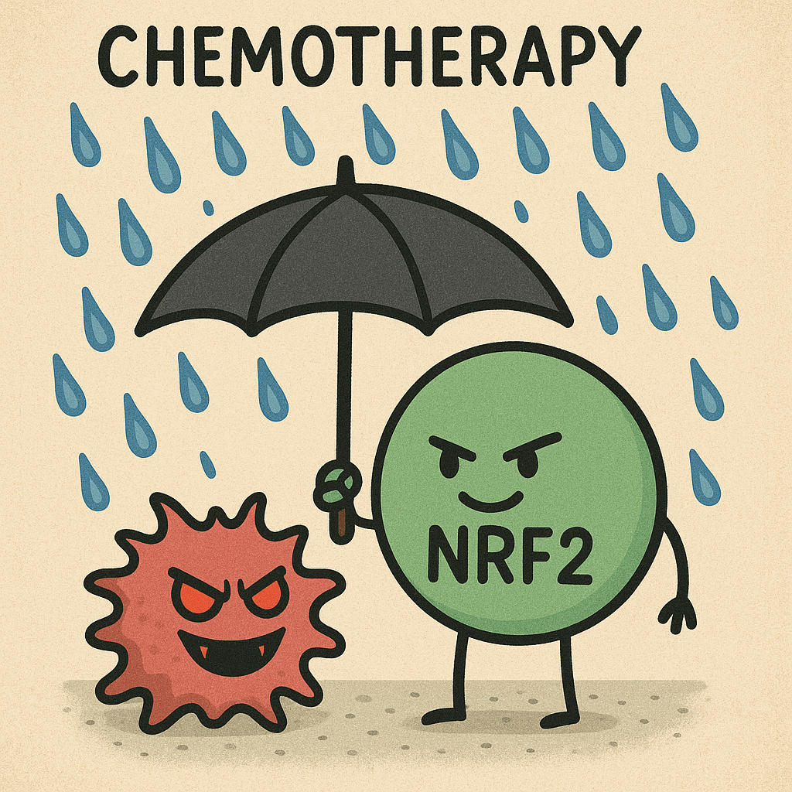
A case study in this strategy (iii)
21
This approach allowed us to choose different genes to use as markers to stratify the cancers
This revealed a novel group of basal cancers with particularly bad survival
Novel group characterised by NRF2 overactivity – this is a druggable target in other cancers
Our work goes beyond a mutation-only classifier

Slide 23
If a single classification strategy is not practical, we need to keep asking biologically and clinically relevant questions to find groups of patients we can treat more effectively.

Slide 24
- END -
Andrew Mason
andrew.mason@york.ac.uk
asmasonomics.github.io

